Slide 1
Database & Analytics Programming Project
Team Members :
Harsh(x18187340)
DevaRaju(x18181422)
Imran(x17119308)
Vijit(x18199429)

Slide 2

Analysis
Research Question
Finding Root causes of death due to factors like Drug consumption, Shooting Incidents and Criminal Records .
Estimating death rates in United States of America affected by above factors mentioned.
Resources
Python
Postgres
MongoDB
Jupyter IDE
Oracle Virtual Machine – Linux(Debian)

Slide 3
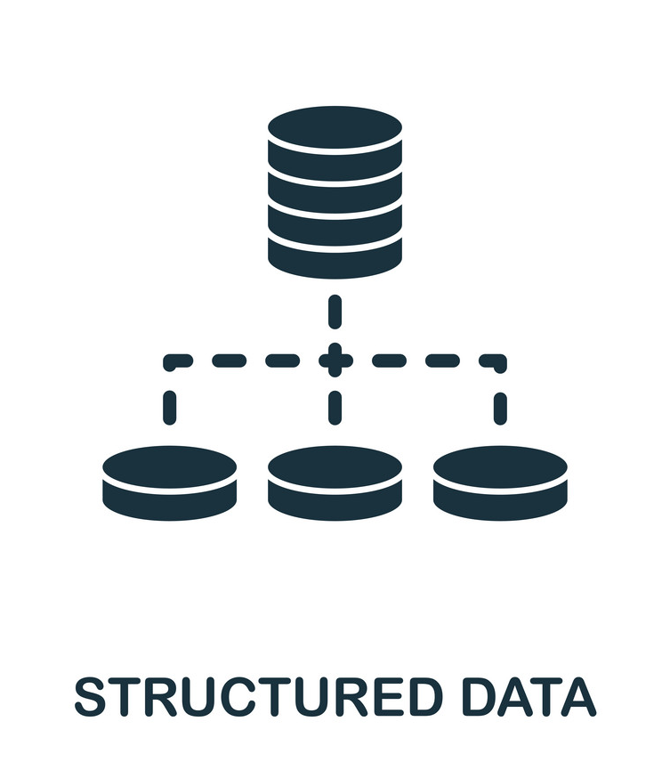





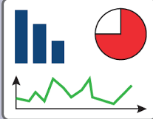

Methodology
API
Store
Store
Data Processing
Converting Raw Data
< Pandas>
Visualize

Slide 4
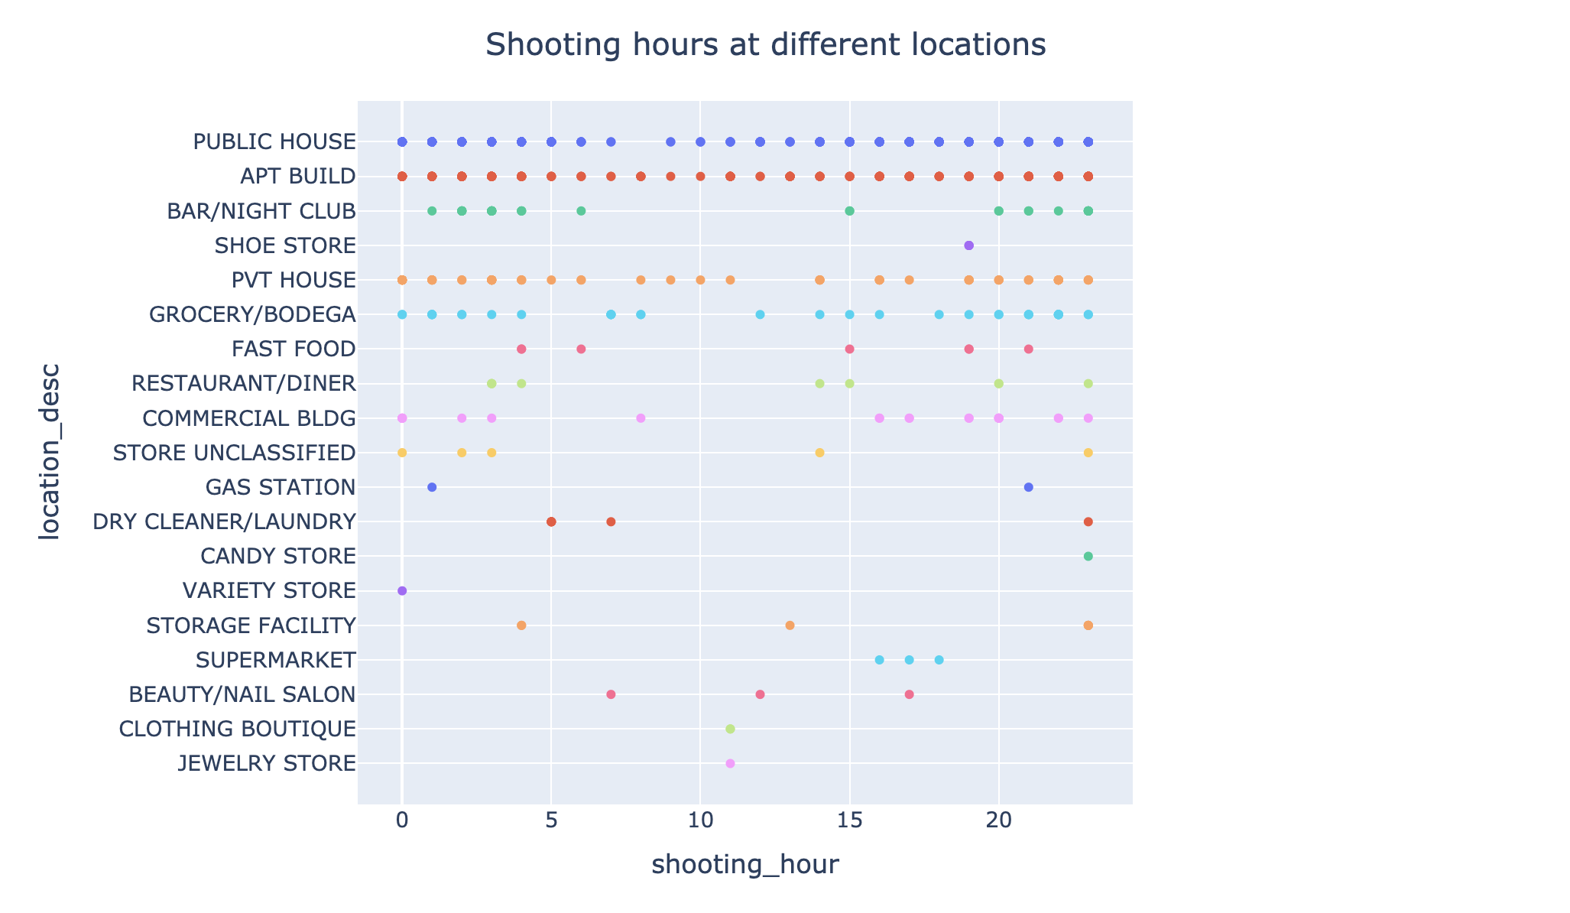
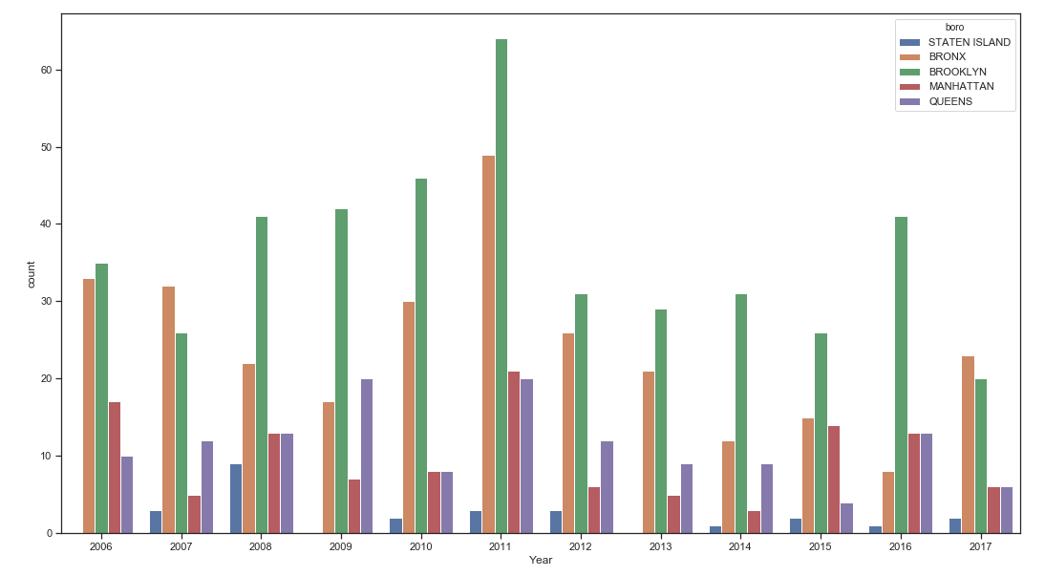
Shooting Incident Dataset
Key Variables :
Target Location(Boro/Crime Scene)
Time of death (in hours)

Slide 5

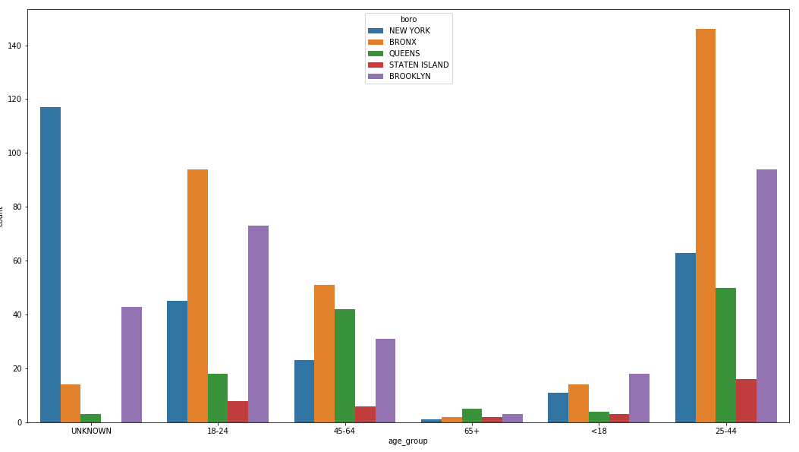
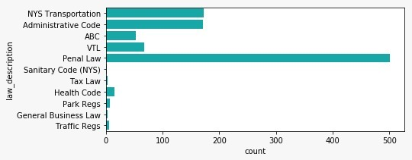
Criminal Court Dataset
Key Variables :
Age Group
State(Boro)
Law Description

Slide 6

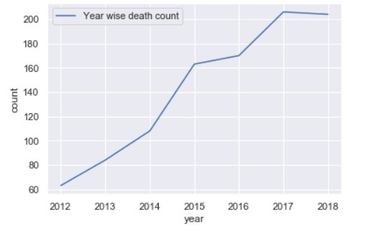
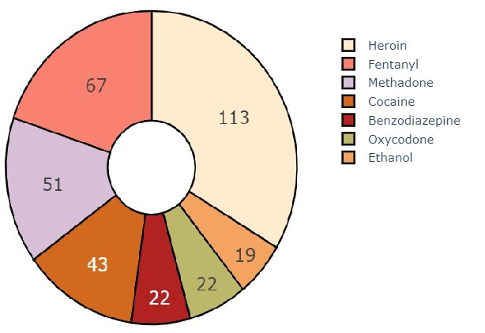
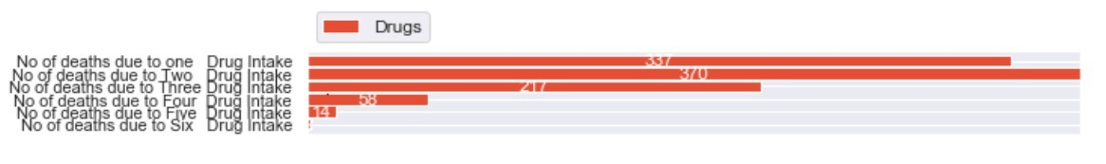
Death by Drugs Dataset
Key Variables :
Location
Drug Intake e.g. Cocaine

Slide 7

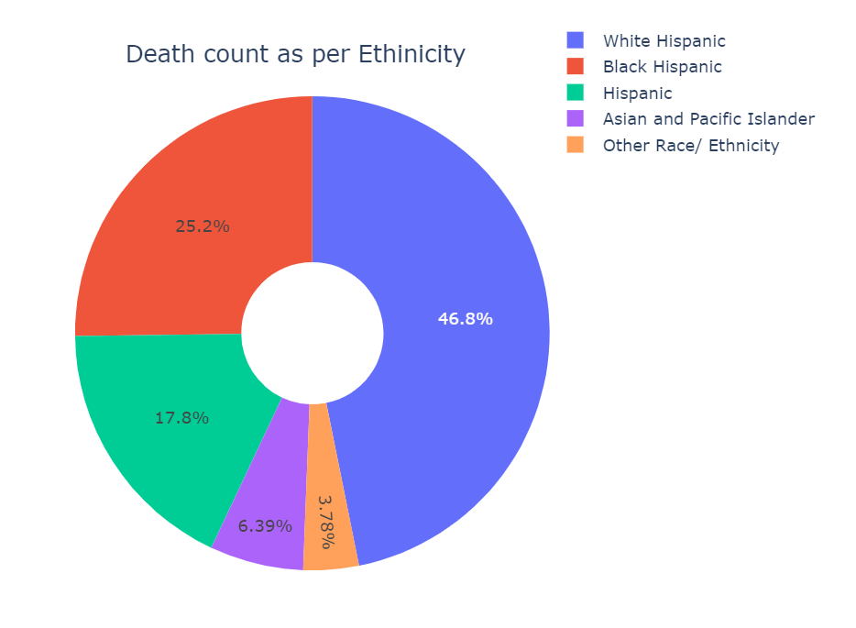
Leading Death cause Dataset
Key Variables :
Leading causes
Death rate

Slide 8
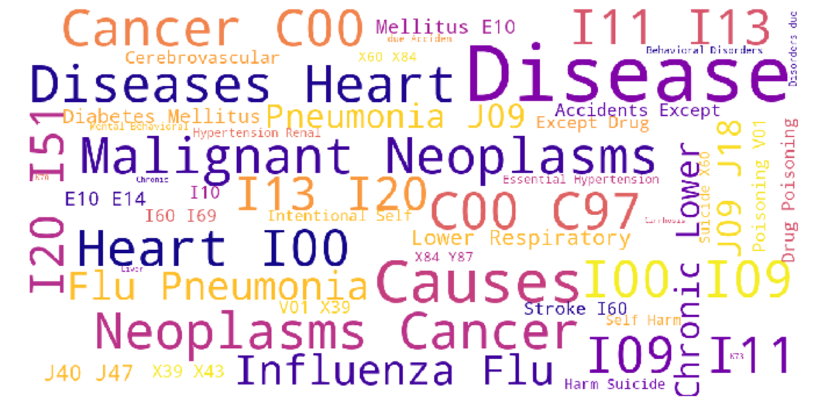

Slide 9
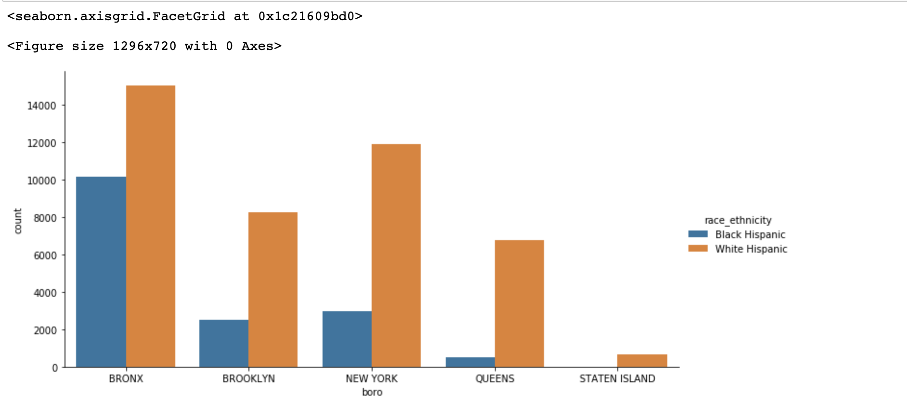
Conclusion
Death
Crime
Join

Slide 10
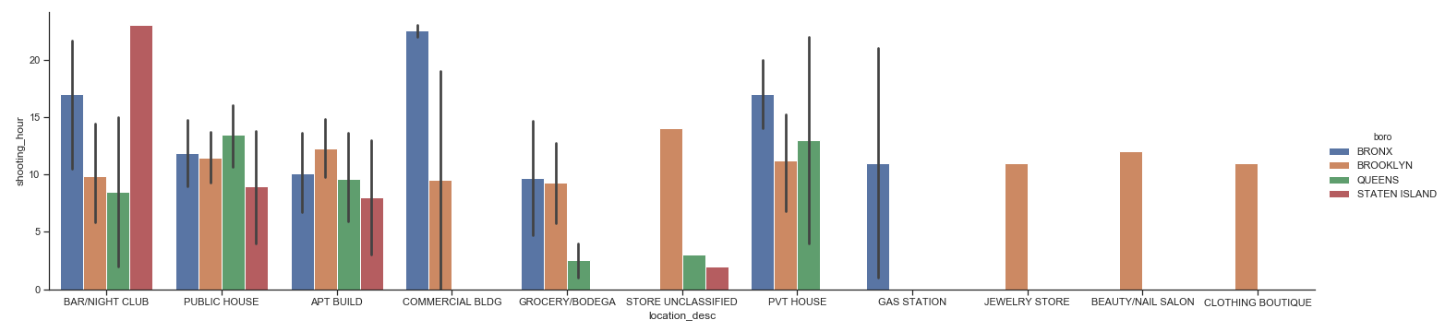
Drug
Conclusion
Shoot
Crime
Join

Slide 11
Thanks!
Any questions?

